Slide 1

Data Acquisition Systems
Project of a station for detecting air quality and temperature
Massimiliano Visintainer
N. 97742

Slide 2
Data Acquisition Systems
The station foresees the reading of two sensors:
LM35 temperature sensor
DS 18B20 temperature sensor
SD011 particle sensor for detecting air quality
The station aims :
To detect the temperature and the parameters identified by the particle sensor
To display the detected values
To have a relay activated upon exceeding a pre-established temperature

Slide 3
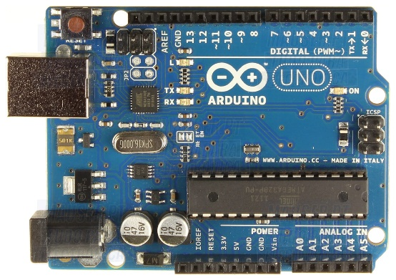
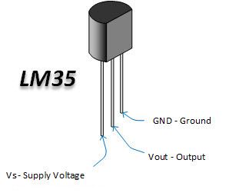
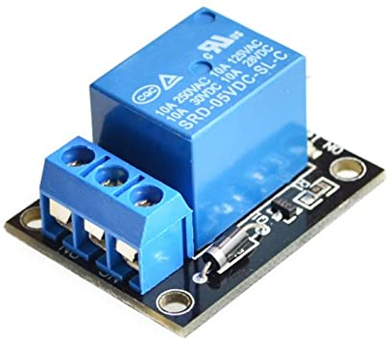
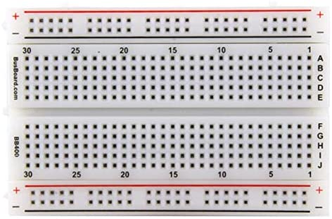
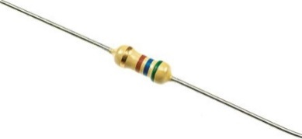
Data Acquisition Systems
Components required:
Arduino Uno
Breadboard
Temperature Sensor LM 35
Temperature Sensor DS 18B20
SD011 Particle Sensor for air quality
Relay 5 V
Jumpers
Resistors

Slide 4
Gantt Chart

